Slide 1


S-TIP: Seamless Threat Intelligence Platform
#BHUSA @BLACKHATEVENTS

Slide 2





About Us
Researchers @ Fujitsu System Integration Laboratories, Tokyo
Koji Yamada
Toshitaka Satomi
Ryusuke Masuoka
2 years CSIRT activities at FJC-CERT, Fujitsu
6 years research and development in Cyber Threat Intelligence
Now interested in MITRE ATT&CK
12 years of development of insurance systems in Japan
8 years research and development in Cyber Threat Intelligence (CTI)
Interested in OSS activities of cyber security.
Over 30 years of ICT research and 20 years of ICT research management
Interested in cybersecurity technologies and policies
Current focus on Cyber Threat Intelligence (CTI)
@ykoji8681
@stmtstk
@rmasuoka

Slide 3
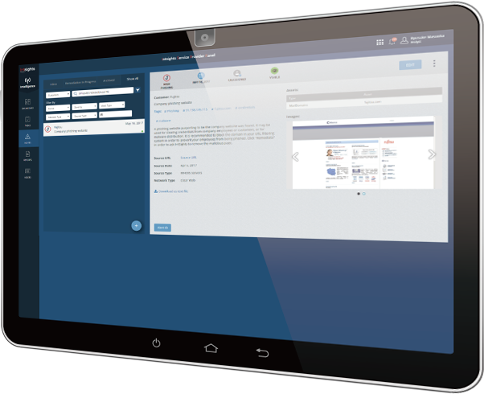
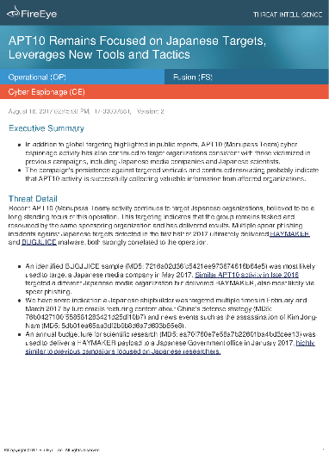
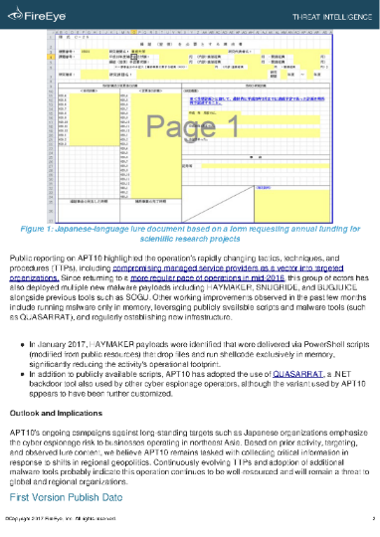
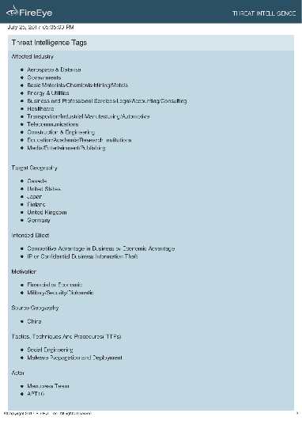
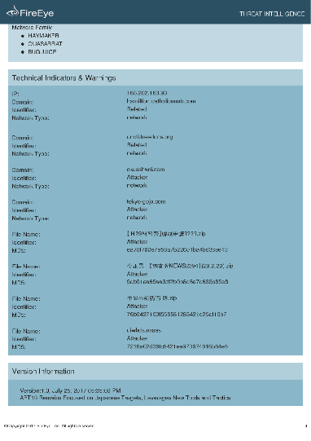
1. Human CTI
Phone
Sharing
Email
Awareness
SNS
(social media)
Web sites which provide CTI
Reports from security vendors

Slide 4




2. System CTI
Structured Threat
Information eXpression
Trusted Automated eXchange
of Indicator Information
Standardized by OASIS CTI Technical Committee
Latest version is STIX 2.1 / TAXII 2.1

Slide 5









S-TIP Features
Integrates Human CTI and System CTI seamlessly through STIX DB
Human CTI
System CTI
PC
Open Source
CTI
Smart-phone
DHS AIS
SNS
DB
Commercial
CTI
Ticketing System
Splunk /
SOAR
Security Appliances
S-TIP
Seamless Threat Intelligence Platform

Slide 6
S-TIP Functions
CTI Element Extractor
CTI Graph Analytics
Integration with other platforms

Slide 7

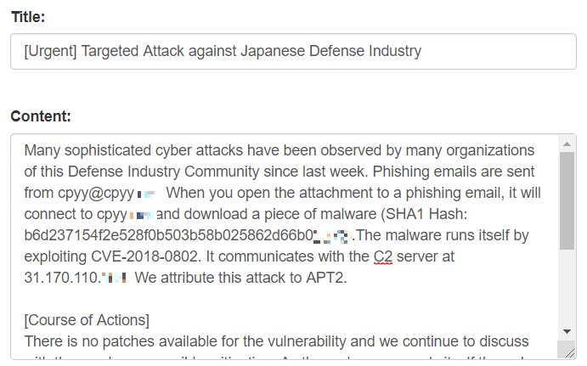
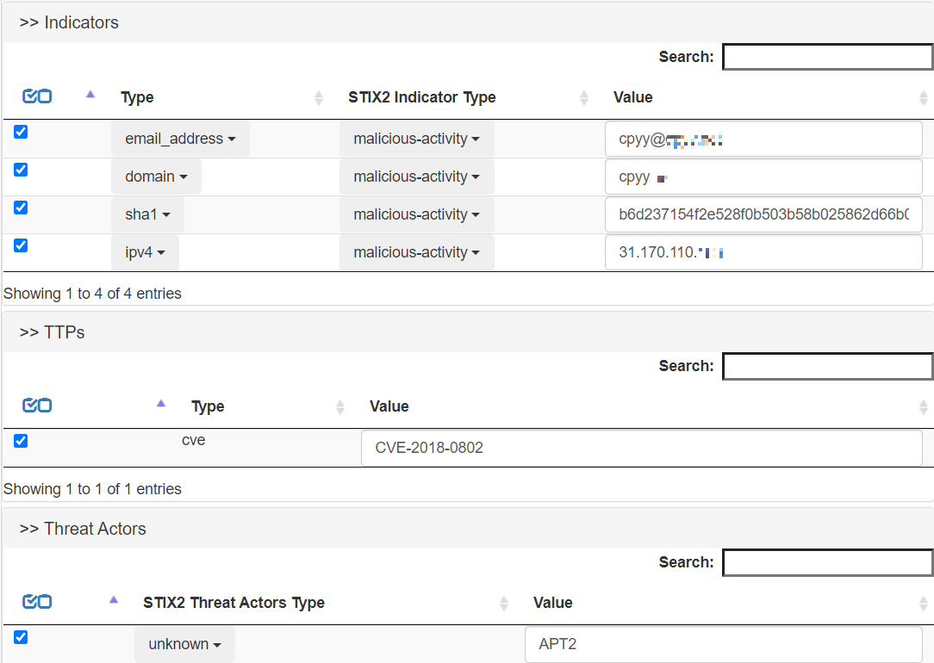

CTI Element Extractor

Slide 8
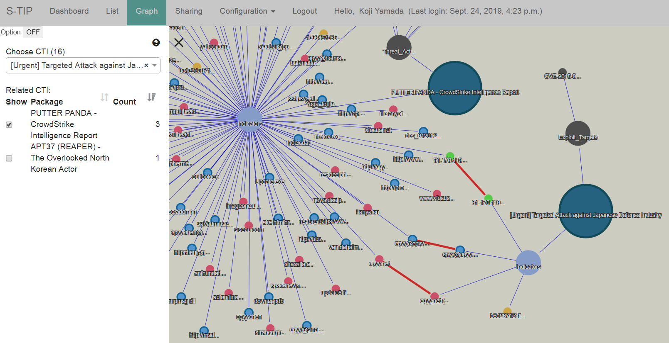
CTI Graph Analytics

Slide 9
Integration with Other Platforms
Slack
Splunk
MISP
Ticketing System
- JIRA
SOAR
- Phantom

Slide 10
S-TIP Demo

Slide 11
S-TIP Basic Information
Requirements
- Python 3.6+
- Django
- MongoDB
- MySQL
Docker image is available
STIX/TAXII support
- Version 1 & 2 (including latest version: 2.1)
- Activities on Interoperability Test in OASIS

Slide 12
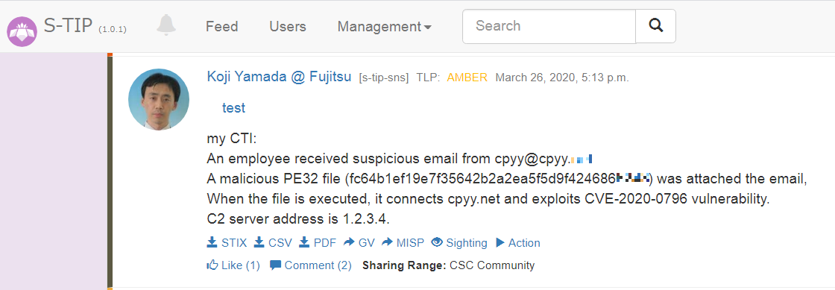
S-TIP Architecture
API
SNS
(Social Networking
Service)
(TAXII server on the Internet)
RS
(Repository System)
DB
GV
(Graph View)
API

Slide 13

Thank you!
https://github.com/s-tip

